Slide 1


PROJECT ON
MYNTRA WEBSITE DATA SCRAPING
AND ANALYSIS USING SELENIUM
Name: Sura Varsha
Batch: 435
Innomatics Research Labs

Slide 2

AGENDA
Business Problem
Problem Statement
Business Objective
Data Source
Visualization
Recommendations & Insights
Conclusion

Slide 3

BUSINESS PROBLEM:
Myntra’s product data is available only in unstructured web formats, making it difficult for businesses to analyze pricing, brand performance, and customer demand. This lack of structured data limits data-driven decision-making and competitive analysis.

Slide 4
PROBLEM STATEMENT:
Developed a Selenium-based web scraping system to extract around 2000 product listings from Myntra, followed by data cleaning, exploratory data analysis, and hypothesis testing to identify pricing trends, customer preferences and brand performance in the e-commerce fashion domain.

Slide 5

BUSINESS OBJECTIVE:
To automate the extraction of product data from the Myntra e-commerce platform using Selenium and perform exploratory data analysis to uncover pricing, brand insights.

Slide 6
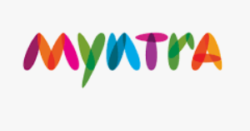
DATA SOURCE:
The data is collected from the Myntra official website using Selenium web automation. Product information such as brand name, product title, price, and ratings is scraped from dynamically loaded web pages.
The dataset consists of 1711 rows and 4 columns.

Slide 7
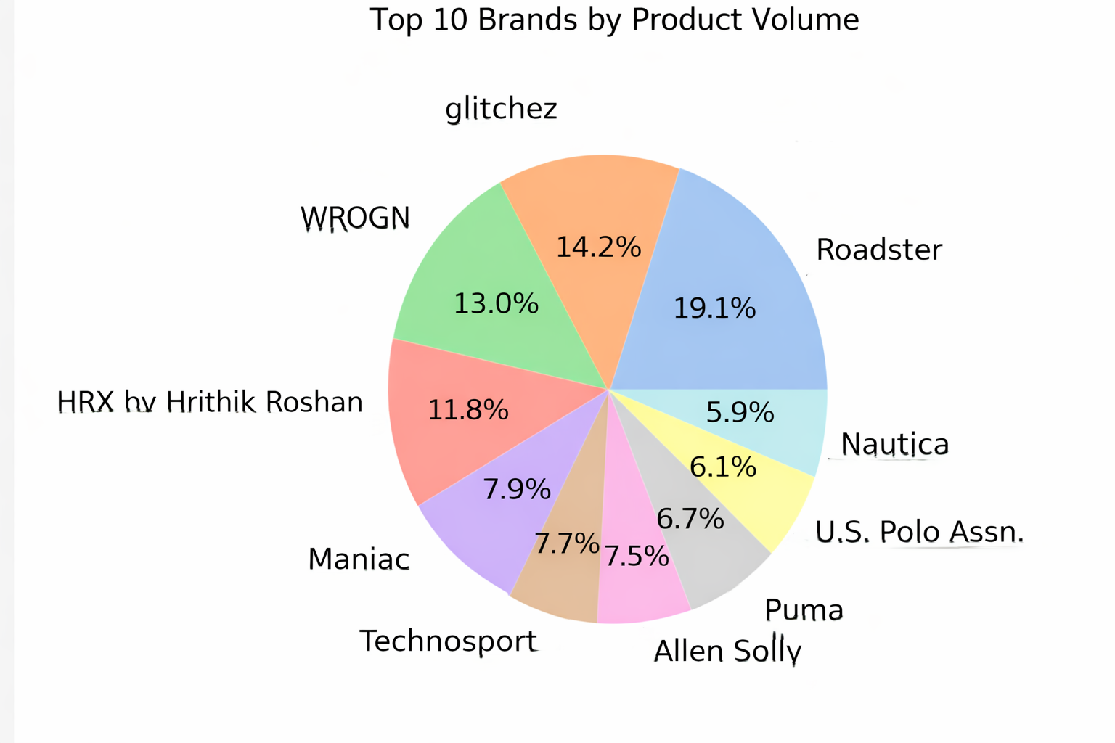
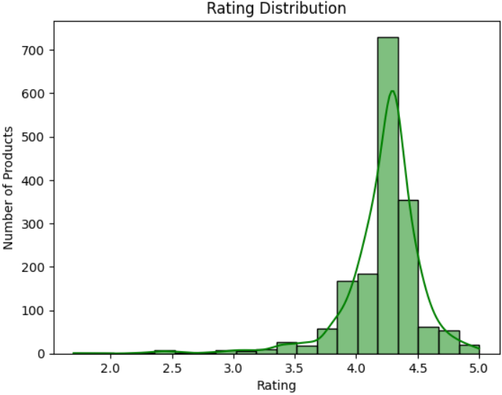
VISUALIZATION:

Slide 8
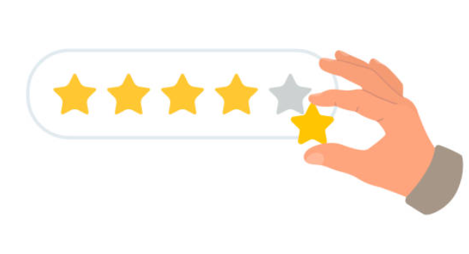
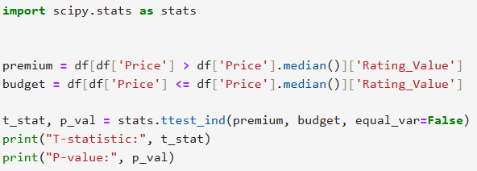
Do premium-priced products have higher ratings than budget products?
T-statistic: 6.712652790969357
P-value: 2.604836625794594e-11

Slide 9
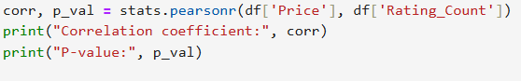

Does the number of ratings correlate with the product price?
Correlation coefficient: -0.03289169491728786
P-value: 0.17385730859360185

Slide 10
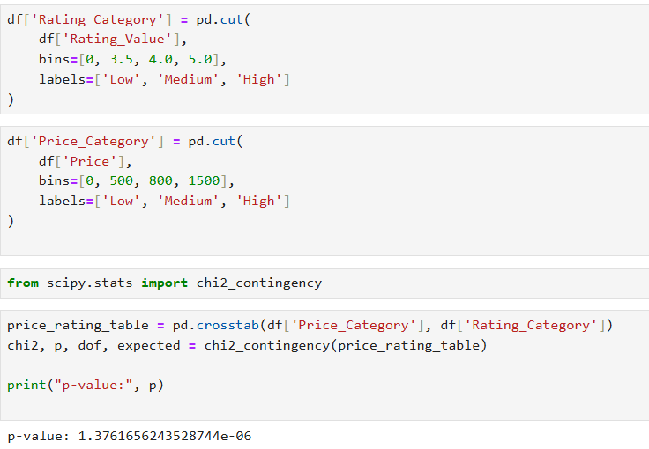
Is there an association between Price Range and Rating Category?

Slide 11
RECOMMENDATIONS AND INSIGHTS:
Focus on high-rated and popular products to boost sales and customer loyalty. Analyze low-performing products to identify areas for improvement in quality, features, or design. Use insights from product trends and customer preferences to make strategic business decisions and stay competitive in the market.
Roadster has the highest number of products, making it the most widely available brand on Myntra.
All the top 10 brands have average ratings close to 4.5–4.8, indicating that customers generally rate these brands highly.

Slide 12
CONCLUSION:
The Myntra website data scraping and analysis project successfully extracted and organized product information using Selenium, enabling insights into trends, pricing, and ratings. This automated approach demonstrates the efficiency of web scraping for market analysis and data-driven decision making.

Slide 13


Slide 14


